Slide 1
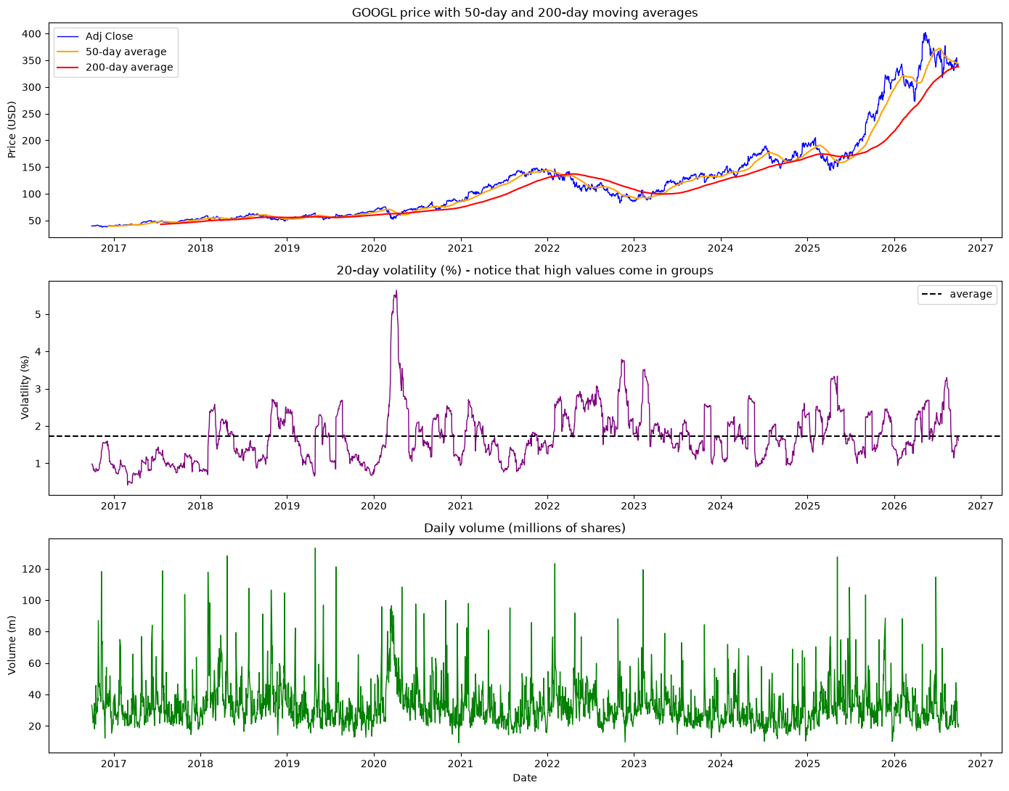
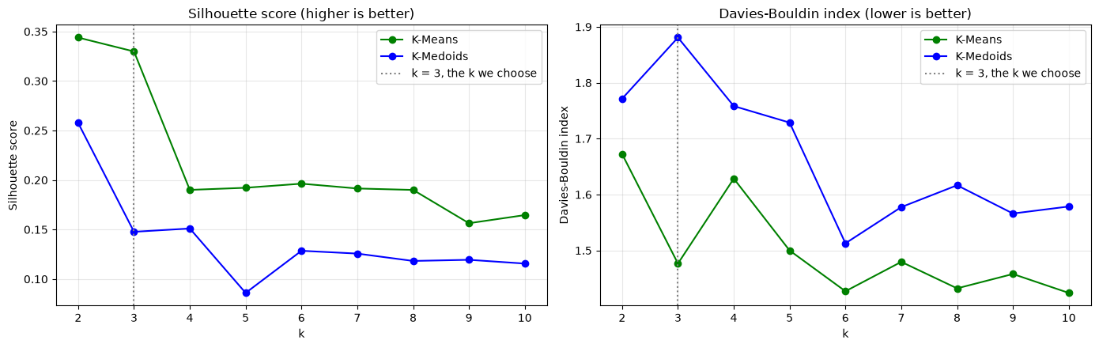
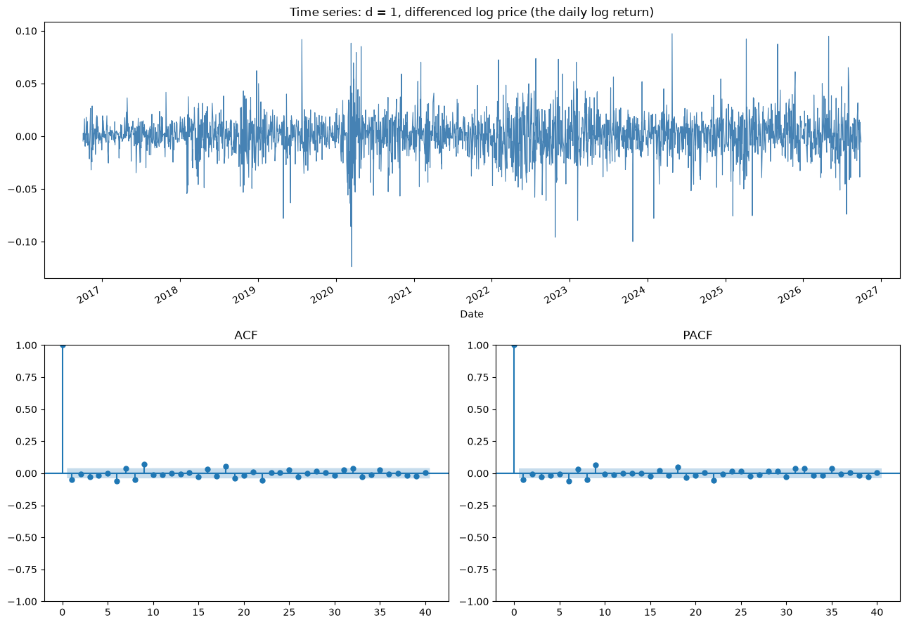
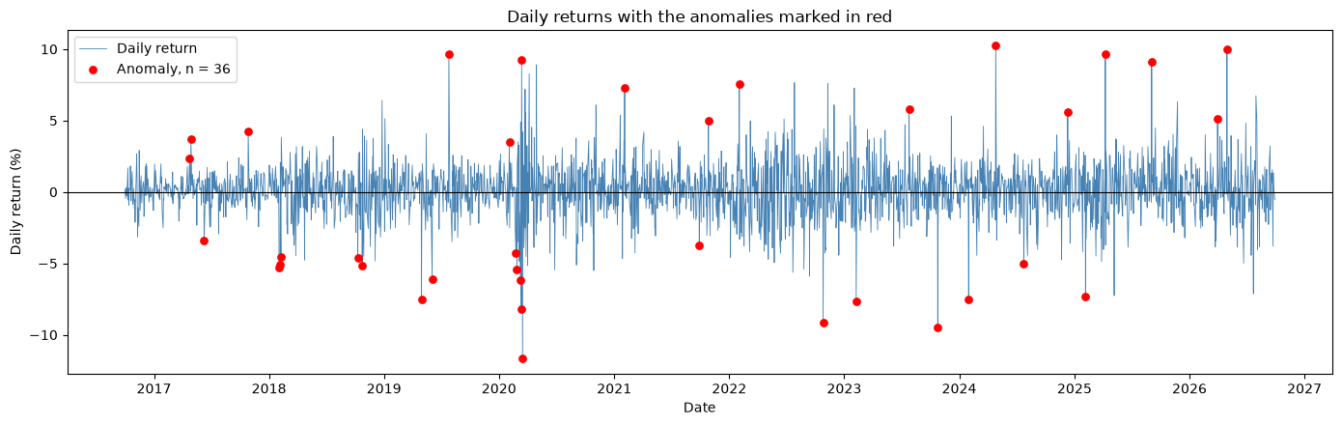
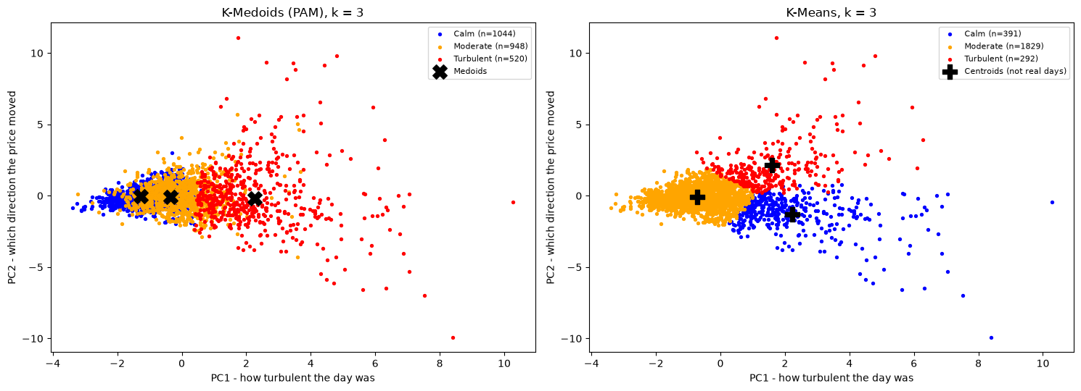
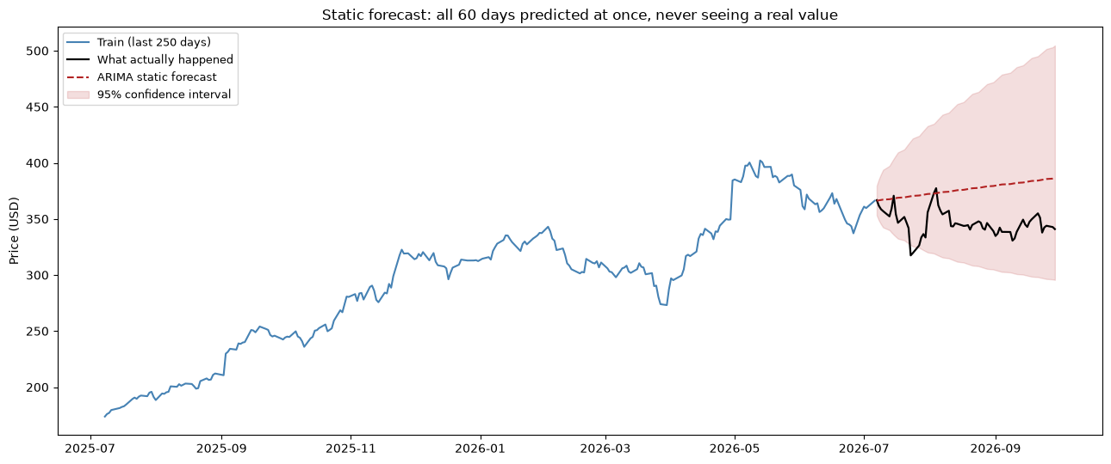
Market Regimes and Price Forecasting for Alphabet Inc. (GOOGL)
Unsupervised clustering (K-Means vs K-Medoids) and ARIMA on ten years of daily prices
Zaw Moe Htike · CCT College Dublin · Machine Learning 2, Continuous Assessment · October 2026
ABSTRACT
DATA
FINDINGS
Choosing k (Q2)
Ten years of daily Alphabet (GOOGL) prices from Yahoo Finance (2,532 rows; 2,512 days and seven engineered features after cleaning) are used for two tasks.
K-Means and K-Medoids segment the days into Calm, Moderate and Turbulent regimes, and K-Means separates them better on both validation indices. An ARIMA model is then identified by the Box-Jenkins procedure and used to forecast 60 held-out days.
Yahoo Finance, GOOGL daily OHLCV, 1 Sep 2016 to 29 Sep 2026: the permitted domain and window.
Features: Return, Range_Pct, Gap_Pct, Volatility_20, Momentum_20, Volume_Ratio, Log_Volume. Adj Close is used throughout because it corrects for splits and dividends. Prices are non-stationary while returns are not, so every clustering feature is scale-free.
Regimes and their similarity (Q1)
Silhouette peaks at k = 2 for both algorithms, while Davies-Bouldin is lowest at k = 10 (K-Means) and k = 6 (K-Medoids). Neither optimum is useful: k = 2 collapses the market into up and down days. k = 3 is defensible on both curves and matches the three regimes under test.
Calm 1,044 days (61.5% up), Moderate 948 days (53.6% up), Turbulent 520 days (38.1% up). The mean daily range widens from 1.4% to 2.3% to 3.5%, and the mean return turns negative (-0.51%) in Turbulent.
Q1: distances between the real medoid days are Calm-Moderate 2.04, Moderate-Turbulent 3.27 and Calm-Turbulent 3.58, so adjacent regimes are the most alike and the extremes are the most distinct.
Trend, seasonality and anomalies
RESEARCH QUESTIONS
Trend: GOOGL grew 23.96% a year, so the series cannot be stationary and d will be at least 1.
Seasonality: weak and not useful; the monthly decomposition is dominated by trend.
Anomalies: 36 days (1.4%) are news days, not calendar days. The largest group is 2020 (the COVID crash; 16 March 2020 fell 11.63%), and many others fall on Alphabet results dates, such as 26 April 2024 (+10.22%).
Q1. How can similarity and dissimilarity between the discovered regimes be measured?
Q2. Which clustering solution is preferable, and on what evidence?
Q3. How are the ARIMA parameters (p, d, q) determined, and what are the strengths and limits of the forecast?
CLUSTERING
K-Means centres a cluster on an average; K-Medoids centres it on a real trading day. Both run on the same standardised data, so the comparison isolates that single decision.
PYTHON CODE AND METHOD
pandas cleans the three-row Yahoo header, the dates and the duplicates. Seven scale-free features are engineered, then standardised with StandardScaler. KMeans (scikit-learn) and kmedoids (pyclustering, on a 2,512 x 2,512 distance matrix) run for k = 2 to 10, scored by silhouette_score and davies_bouldin_score. statsmodels supplies adfuller, kpss, seasonal_decompose, plot_acf, plot_pacf and ARIMA. Every notebook cell is commented.
CONCLUSIONS
Q2: K-Means is preferred, being better on both indices. Silhouette judges how well each day fits its own cluster, Davies-Bouldin judges whole clusters; two different measures agreeing makes the choice safe. Both values are modest, so the regimes genuinely overlap.
Q3: the Box-Jenkins steps are transparent and reproducible, and ADF and KPSS agree on d = 1. The static forecast drifts up from 366.22 to 386.29 with a widening 95% interval, while the chart shows the actual price ending below it.
Limitations: the model was selected on AIC, which measures fit rather than forecast skill; no out-of-sample error was calculated, so no accuracy claim is made. One stock, one window, one static forecast path.
CLUSTER VALIDATION
Identifying ARIMA (p, d, q)
K-Means leads on both indices at k = 3.
d: the price is non-stationary (ADF +1.079, p = 0.995; KPSS p = 0.01). After one difference ADF is -16.908 and KPSS p = 0.10, so both tests agree and d = 1. A second difference is avoided because over-differencing widens the forecast intervals.
p and q: the undifferenced ACF barely decays across 40 lags. In the differenced series both ACF and PACF fall inside the confidence band after one small spike at lag 1, ambiguous between AR(1) and MA(1).
Because the plots cannot decide, AIC does (Akaike, 1974). A grid search over the shortlist gives ARIMA(1,1,0) the lowest AIC (-12,582.7).
Measure at k = 3 | K-Means | K-Medoids
Silhouette (higher is better) | 0.330 | 0.148
Davies-Bouldin (lower is better) | 1.476 | 1.881
Best k by silhouette | 2 | 2
Best k by Davies-Bouldin | 10 | 6
REFERENCES
Akaike, H. (1974) 'A new look at the statistical model identification', IEEE Transactions on Automatic Control, 19(6), pp. 716-723.
Box, G.E.P., Jenkins, G.M., Reinsel, G.C. and Ljung, G.M. (2015) Time Series Analysis: Forecasting and Control. 5th edn. Hoboken, NJ: John Wiley & Sons.
Davies, D.L. and Bouldin, D.W. (1979) 'A cluster separation measure', IEEE Transactions on Pattern Analysis and Machine Intelligence, PAMI-1(2), pp. 224-227.
Dickey, D.A. and Fuller, W.A. (1979) 'Distribution of the estimators for autoregressive time series with a unit root', Journal of the American Statistical Association, 74(366), pp. 427-431.
Kaufman, L. and Rousseeuw, P.J. (1990) Finding Groups in Data: An Introduction to Cluster Analysis. Hoboken, NJ: John Wiley & Sons.
Kwiatkowski, D., Phillips, P.C.B., Schmidt, P. and Shin, Y. (1992) 'Testing the null hypothesis of stationarity against the alternative of a unit root', Journal of Econometrics, 54(1-3), pp. 159-178.
Novikov, A.V. (2019) 'PyClustering: data mining library', Journal of Open Source Software, 4(36), p. 1230.
Pedregosa, F. et al. (2011) 'Scikit-learn: machine learning in Python', Journal of Machine Learning Research, 12, pp. 2825-2830.
Rousseeuw, P.J. (1987) 'Silhouettes: a graphical aid to the interpretation and validation of cluster analysis', Journal of Computational and Applied Mathematics, 20, pp. 53-65.
Seabold, S. and Perktold, J. (2010) 'Statsmodels: econometric and statistical modeling with Python', Proceedings of the 9th Python in Science Conference. Austin, TX, pp. 92-96.
Yahoo Finance (2026) Alphabet Inc. (GOOGL) historical data. Available at: https://finance.yahoo.com/quote/GOOGL/history/ (Accessed: 28 October 2026).

